Slide 1

Basic Income for Care Leavers in Wales Pilot Conference
Event highlights pack

Slide 2
Contents (Click links to jump to section)
Event Summary
Agenda
Welcome
Chair’s Welcome
Video messages from Ministers
Introduction
Keynote speaker: Prof. Sir Michael Marmot
Questions for Prof. Sir Michael Marmot
The Basic Income for Care Leavers in Wales Pilot and Evaluation
The Basic Income Pilot
Evaluation of the pilot
Insights from research on basic income schemes and interventions for care leavers
Dr Miriam Laker-Oketta, Give Directly
Hannah Webster, Royal Society of Arts
Dr Eleanor Ott, Centre for Evidence and Implementation
Questions for the speakers
Discussion
Reflections
Reflections: Prof. Guy Standing
Questions for Prof. Guy Standing
Resources
Speaker biographies

Slide 3
Event Summary
The Basic Income for Care Leavers in Wales Pilot (BICLWP) Conference was a half-day online event which took place on 15th December 2022, convened by the Wales Centre for Public Policy on behalf of the Welsh Government.
The purpose of the conference was to ensure that, in tandem with its evaluation of the pilot, the Welsh Government draws on the best available research evidence about the implementation and impact of basic income schemes and wider support for care leavers.
In total, 84 people attended the event from a wide range of organisations including universities, third sector organisations, and national and local governments. Attendees joined from within Wales and across the UK, as well as from elsewhere in Europe, and Canada.
Event objectives
To provide opportunities for discussion of:
The Basic Income for Care Leavers in Wales pilot and the evaluation that the Welsh Government has commissioned;
Key lessons from other research on basic income schemes;
Ways to support or strengthen the Welsh Government evaluation; and
Additional policies that could complement the Basic Income Pilot Scheme and increase its impact.

Slide 4
Agenda
Click on each speaker’s name to read their biography
Welcome Chair: Professor Steve Martin (Wales Centre for Public Policy) Video messages from Jane Hutt MS, Minister for Social Justice, and Julie Morgan MS, Deputy Minister for Social Services
Introduction Keynote Speaker: Professor Sir Michael Marmot (University College London)
The Basic Income for Care Leavers in Wales Pilot and evaluation Adam Jones and Launa Anderson (Welsh Government) Professor Sally Holland and David Westlake (CASCADE, Cardiff University)
Insights from research on basic income schemes and interventions for care leavers Dr Miriam Laker-Oketta (Give Directly) Hannah Webster (Royal Society of Arts) Dr Eleanor Ott (Centre for Evidence and Implementation)
Discussion How can research and the research community best support the success of the pilot and its evaluation?
Reflections Professor Guy Standing (SOAS, University of London)
Summary, key messages, and next steps Chair: Professor Steve Martin (Wales Centre for Public Policy)
Conference Close

Slide 5
Welcome
Professor Steve Martin, Wales Centre for Public Policy

Slide 6
Chair’s Welcome
Prof. Steve Martin opened the conference and thanked everyone for joining. He highlighted that poverty is a persistent issue in Wales, and one which WCPP had recently completed a significant amount of work on.
Care leavers are one of the groups most likely to experience poverty, meaning that schemes which aim to improve outcomes for care leavers, such as the Basic Income for Care Leavers in Wales Pilot, are incredibly important. The pilot is currently trialling a basic income scheme with around 500 care leavers in Wales.
Featuring contributions from the Welsh Government, the appointed evaluators, and leading academics and researchers, the event provides an opportunity to share information on the pilot and allow for deliberation and discussion.

Slide 7
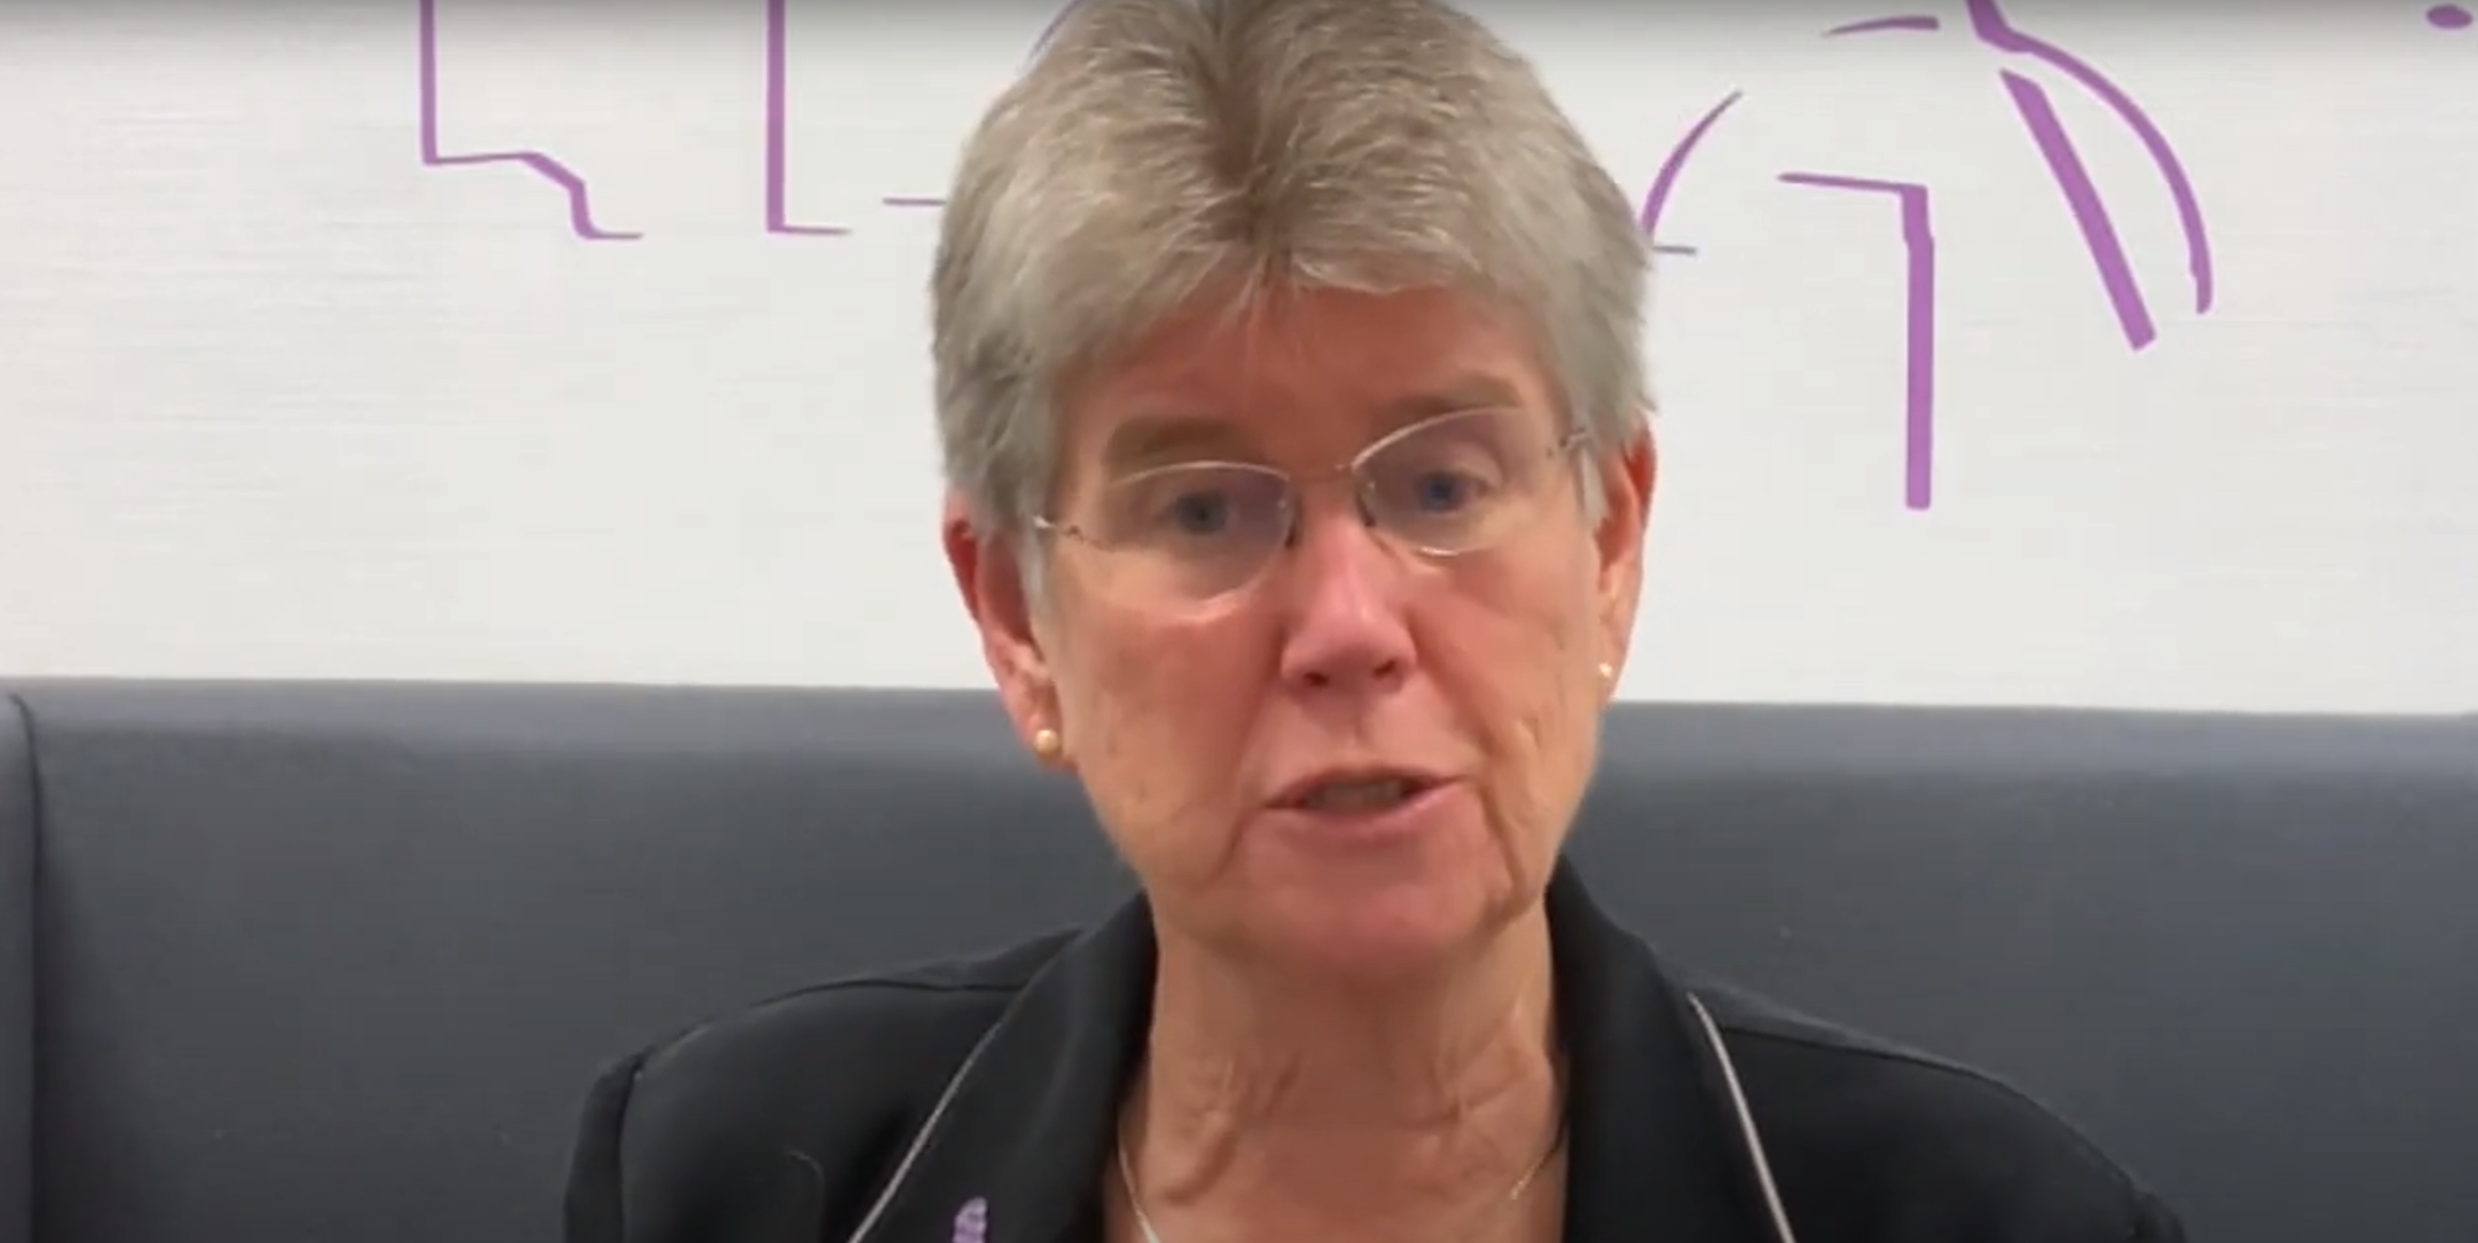
Video messages from Ministers
(Click on the image to watch the presentation on Youtube)

Slide 8
Introduction
Professor Sir Michael Marmot, University College London

Slide 9
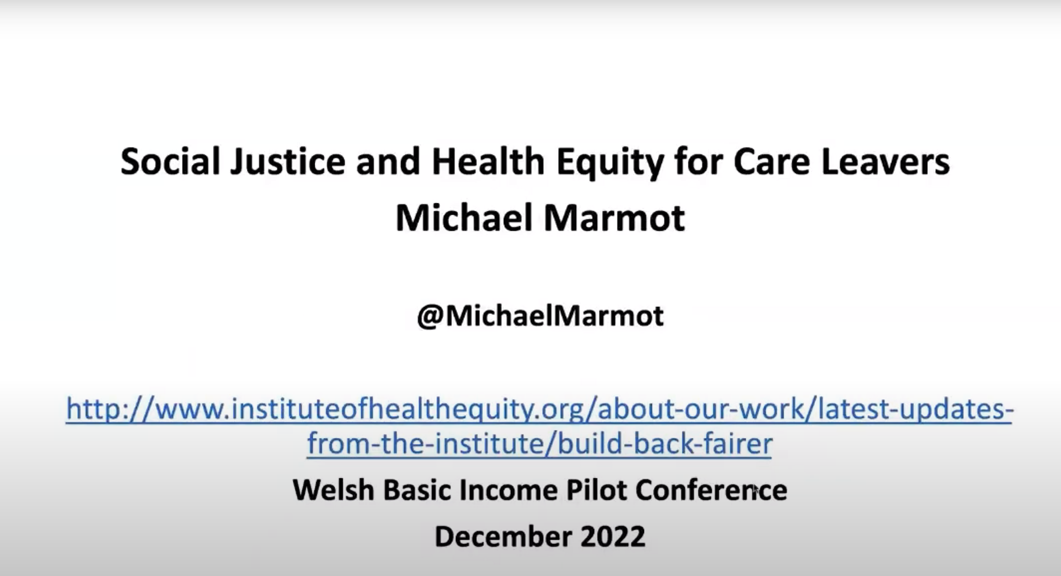
Keynote speaker: Prof. Sir Michael Marmot
(Click on the image to watch the presentation on Youtube)

Slide 10



Prof. Sir Michael Marmot: situating the pilot
Professor Marmot’s keynote address situated the pilot within the context of social justice and health equity.
Income and health outcomes are heavily intertwined, as highlighted by the correlation between income and life expectancy. There have been three recent challenges to health inequalities in the UK:
Austerity
COVID-19
Cost of Living Crisis

Slide 11
Prof. Sir Michael Marmot: recent trends
Professor Marmot highlighted several trends relating to care leavers, and those with low incomes more broadly, in the context of these recent challenges.
Adverse childhood experiences, which are of greater likelihood for children growing up in care, become more common with greater deprivation.
Mental health conditions are more common in those with adverse child experiences and more likely for those growing up in care.
Falling behind with payments is much more likely for those with a mental health condition.
Those in non-parental care are significantly less likely to be employed, and more likely to be unemployed in their 20s, 30s and 40s, with this being especially true for those in residential care.
Care leavers are more likely to report they are struggling to cope financially compared to young people in the general population.
The COVID-19 pandemic exposed inequalities in society and amplified them, both in terms of health and income distribution.
During the recent cost of living crisis, the least well off have been the most impacted by inflation, as energy and food, which have experienced high inflation, make up a greater proportion of spending for that group.

Slide 12
Prof. Sir Michael Marmot: Income and health inequalities
Income relates to several of the six Marmot principles for reducing health inequalities set out in Fair Society, Healthy Lives (The Marmot Review, 2010)
Give every child the best start in life
Create fair employment and good work for all
Create and develop healthy and sustainable places and communities
Enable all children, young people and adults to maximise their capabilities and have control over their lives
Ensure healthy standard of living for all
Strengthen the role and impact of ill-health prevention
Prof. Marmot concluded, stating:
“Income is not the only thing that matters, but it surely helps.”

Slide 13
Questions for Prof. Sir Michael Marmot
Do we need better statistical knowledge on income volatility and insecurity; it appears to be a factor that is intensifying these inequalities?
There is evidence that economic insecurity is bad for health. In the English Longitudinal Study Of Ageing, emphasis is placed on wealth – wealth can provide resilience in the context of income insecurity, as income fluctuations matter less with greater wealth.
There has been a huge growth in expensive debt, with those at the bottom requiring extra income to make ends meet. What can we do as researchers to highlight this crisis?
Policymakers place emphasis on short-term solutions for immediate crises; we need to deal with the long-term problems now and not put them off. We do need urgent solutions to urgent problems, but we also need to address the long-term issues. It is quite possible to make credit available to people at an affordable price quickly, but it ought to be part of a longer-term solution.

Slide 14
The Basic Income for Care Leavers in Wales Pilot and evaluation
Adam Jones and Launa Anderson, Welsh Government
Professor Sally Holland and David Westlake, CASCADE, Cardiff University

Slide 15
The Basic Income for Care Leavers in Wales Pilot
Welsh Government officials provided background and context to the pilot, looking at its design and implementation.
The pilot is open to care leavers across Wales turning 18 between 1st July 2022 and 30th June 2023. The amount paid is £1600 per month, pre-tax for 24 months following their 18th birthday (net £1280). The basic income is provided in addition to existing Welsh Government support provided to care leavers, and support in managing finances is also provided. Participation in the pilot and the evaluation is voluntary.
There are four key policy design conditions for the pilot:
Make no participant worse off
No conditionality on income received
Same payment given to everyone
No altering the payment midway through the pilot
Officials have worked with care-experienced young people and the children’s social care sector in the development and design of the pilot.

Slide 16
Evaluation of the pilot
CASCADE (Children’s Social Care Research and Development Centre), a research centre based at Cardiff University, are the appointed evaluators. The evaluation team, comprising two principal investigators from CASCADE, were introduced, along with several co-investigators and subject experts from across the UK.
There are four key principles for the evaluation:
Involving care-experienced young people
Testing and developing theory on how the intervention works
Using a combination of methods and approaches to build a comprehensive picture that can answer a variety of questions about the pilot
Laying foundations for long-term impact
The evaluation has five related research questions:
What is the impact of the pilot on the outcomes it intends to change?
Is the pilot implemented as intended?
How is the pilot experienced?
How does the pilot fit into the overall offer for care leavers in Wales?
What is the cost-effectiveness of the pilot?

Slide 17
Evaluation methods
The first research question relates to whether the pilot has an impact on the intended outcomes. There are a wide variety of outcomes measured, and data will be collected through survey data, administrative data, and an implementation and process evaluation (IPE). Two quasi-experimental comparisons are planned: one with a matched English cohort, and one with Welsh care leavers who are too old or too young to be eligible.
Outcomes of interest | Methods
Wellbeing | Survey data + IPE
Financial literacy and security | Survey data + IPE
Community cohesion and engagement | Survey data + IPE
Ameliorating the effects of poverty | Survey and administrative data
Volunteering and life skills | Administrative data
Physical and mental health | Survey data
Access to labour market/ education/ lifelong learning | Survey and administrative data
The research questions relating to implementation, experience and relation to broader policy will be assessed through IPE, including quantitative and qualitative analysis. These questions will be further developed and disaggregated through coproduction with care-experienced young people.

Slide 18
Insights from research on basic income schemes and interventions for care leavers
Dr Miriam Laker-Oketta, Give Directly
Hannah Webster, Royal Society of Arts
Dr Eleanor Ott, Centre for Evidence and Implementation (CEI)

Slide 19
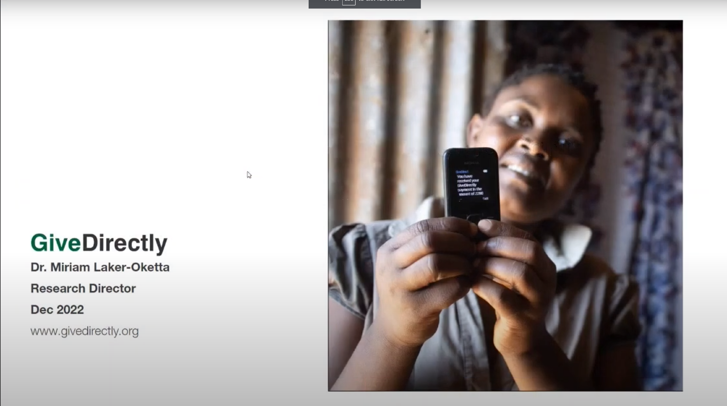
Recording: Dr Miriam Laker-Oketta
(Click on the image to watch the presentation on Youtube)

Slide 20
Dr Miriam Laker-Oketta: key points
Dr Miriam Laker-Oketta discussed several projects run by GiveDirectly involving cash transfers. GiveDirectly is an international aid agency which gives unconditional cash transfers to people living in poverty. It has reached over 1.5 million recipients in fourteen countries.
GiveDirectly is currently leading a twelve year experiment studying the effects of a Universal Basic Income (UBI), to generate evidence on the impact of UBI in developing countries.
Key learning from this project so far (in the context of COVID-19):
Cash transfers improved well-being on measures including hunger, sickness and depression, even given the context of the COVID-19 pandemic.
There were also potential public health benefits, as recipients were less likely to visit hospitals, and had fewer non-commercial social interactions.
The pandemic led to losses in income accrued through starting new enterprises, but recipients suffered smaller increases in hunger (compared with non-recipients).
Recipients pooled money to accrue benefits for the community (e.g. a pre-school teacher).
Recipients invested in a wide range of assets: one invested in musical instruments and started a band
“Not everybody wants a goat, not everybody wants a house. I’m the only one who knows what I really need”

Slide 21
Dr Miriam Laker-Oketta: other trials
How do urban youth spend cash transfers? (Kenya)
Benchmarking skills training vs. cash transfers (Rwanda)
Two groups of participants, both also given cash to purchase a smartphone:
3 instalments
24 instalments
Sizeable and sustained shift to self-employment
Participants reported increased savings, reduced debts, and the ability to pay for better accommodation.
Smartphone enhancing business opportunities and supporting digital inclusion
Comparing a youth skills and entrepreneurship programme with cash transfers, and a combination of both.
A cost-equivalent cash transfer improved the same outcomes as the skills training, and others.
Cash transfers significantly improved five outcomes by more than the skills training, including:
Income
Productive assets
Wellbeing

Slide 22
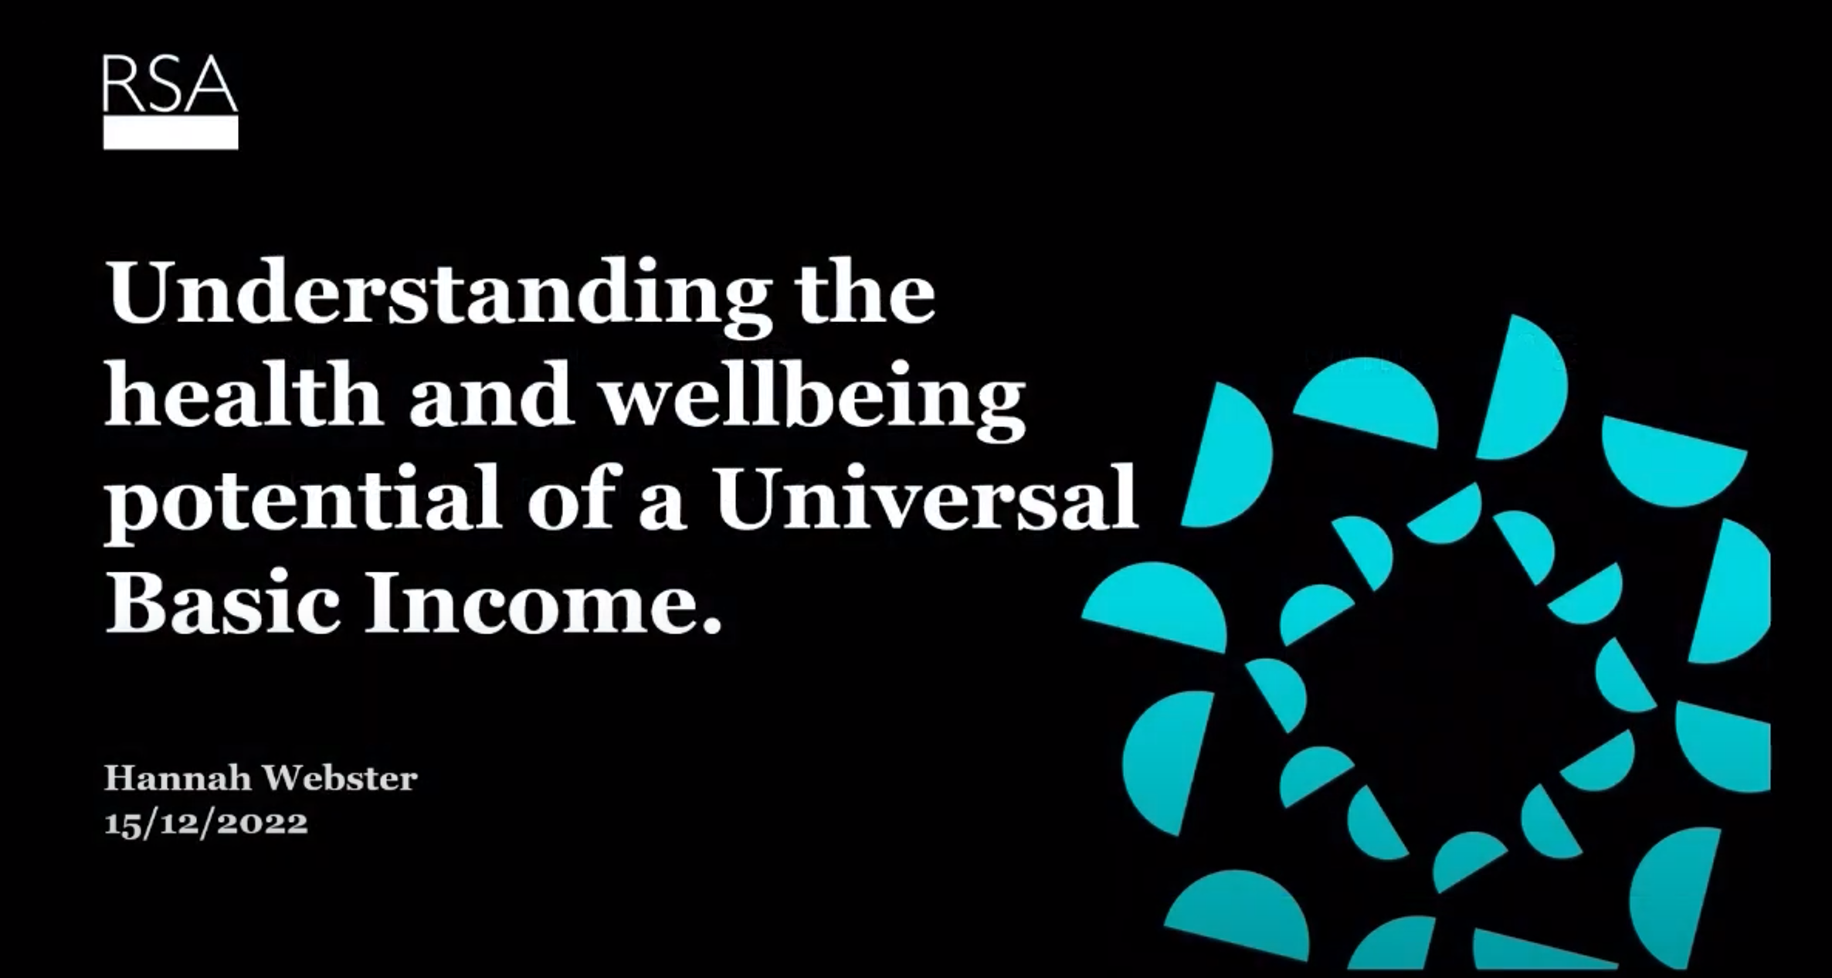
Recording: Hannah Webster
(Click on the image to watch the presentation on Youtube)

Slide 23
Hannah Webster: youth economic insecurity
Hannah Webster discussed findings from RSA projects about the economic security of young people in the UK and the potential for a Universal Basic Income.
Even before the current cost-of-living crisis, around half of young people were living precariously (“just about getting by”, “struggling to get by”, or having a volatile income). 79% of young people receiving Universal Credit said they were living precariously.
Young people are experiencing atomisation: the breaking of societal bonds that should support young people, leaving them isolated and vulnerable. The current social security system is seen to undermine young peoples’ economic security, with few mechanisms to support the transition to adulthood, and a systemic reduction in size of networks and structures of support. Young people saw not having enough money as a personal failing, rather than a failure of the system, and push themselves to live up to societal expectations.
There are a range of financial drivers of stress, anxiety and depression:
Financial planning
Work, university and the balance between the two
A lack of money or anticipation of a lack of money
The inability to get a job due to lack of experience, which in turn prevented them from getting relevant experience, and concerns about finding work in the future
Societal norms around money and status, amplified by media representations of young people’s incomes
Low confidence in their understanding about money issues

Slide 24





Hannah Webster: mental health and BI
Data analysis suggests a correlation between young people’s income quintile and the prevalence of reported clinical depressive disorders. While a broad range of factors impact young people’s mental health, a policy which seeks to improve young people’s economic circumstances could bring wider benefits to mental health and well-being.
When discussing a universal basic income as a policy which could offer these benefits, young people raised some questions about the societal impact of a UBI, but largely identified a range of benefits which could result from a UBI, including:
Increased security
Work/study/life balance
Improving relationships
Alleviating stress
More time for well-being
Removing financial dependencies
Better quality work
Personal fulfilment and long term financial benefit
More opportunities for learning
For physical and mental health
A universal basic income of around £230 per week per adult is estimated to save or delay over 500,000 cases of anxiety or depression amongst 14-24 year olds over a ten year period. A scheme of £63 per week per adult is still estimated to save or prevent around 200,000 cases.

Slide 25
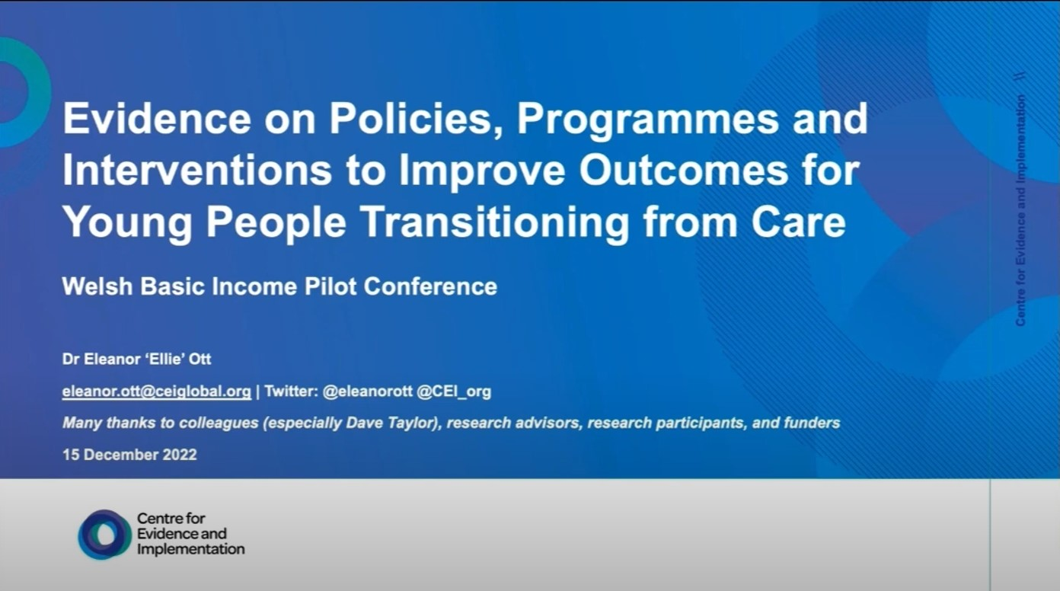
Recording: Dr Eleanor Ott
(Click on the image to watch the presentation on Youtube)

Slide 26
Dr Eleanor Ott: support for care leavers
Dr Eleanor Ott presented evidence on policies, programmes and interventions to improve outcomes for young people transitioning from care. Dr Ott also provided reflections on the involvement of care-experienced young people in research.
Examining the effectiveness of four different types of interventions for young people transitioning from care: independent living programmes, intensive support services, and extended care had very small effects on a number of outcomes. Coaching and peer support services had no significant difference in meta-analyses.
“The scope and strength of current evidence is insufficient to draw conclusions.”
It is important to acknowledge the complexity of providing such services, in an often underfunded context, to a population which is very diverse and which is often presenting complex needs. While some approaches (particularly extended care and intensive support) could have promise, however, it is too early to strongly recommend these approaches.
For research:
There is a role for research in assessing the impact of implementation strategies
It is important to understand the ingredients of interventions: what makes the difference?
There is a need for more common outcome measures in primary research to pool information and understand what we know

Slide 27
Dr Eleanor Ott: care leavers’ mental health
Building on this research, CEI is now undertaking a rapid evidence review looking at the impact of interventions for care-experienced young people on their mental health, and literature on care-experienced young people’s experiences with the implementation of mental health support in the UK.
If young people could prioritise findings from the review:
Young people having ownership and choice over their mental health care and support
Professionals having better understanding of care experiences
More education around mental health and options for support in the general population
Youth participation in research is often modelled as a hierarchy, but needs to be looks at holistically as youth participation depends on the involvement for that particular project.
Ethics and respect are extremely important when involving care-experienced young people in research and need to be navigated carefully:
“Nothing about us without us” – Importance of involving young people and representing their participants, but without overburdening people…
“I’m tired of talking to all these people” – Participants may choose to actively not engage at certain points in interviews, or with research, as they have expressed their views and want the change to be made

Slide 28
Questions for the speakers
While involving care-experienced young people is critical, it will also be important to avoid overload amongst this group – how might that be navigated?
Dr Eleanor Ott: It is important to honour the wishes of research participants, even if that means not involving them, and administrative data can help provide insights into outcomes, but that will not reflect experiences. Ethics and respect are important, as is the involvement of an advisory group. There is huge diversity to the group in the pilot: it is important to involve a range of people.
Hannah Webster: Working with young advisers on economic security work, they joined at the beginning. Young people began to set the agenda, and power is transitioning into their hands. It is an investment of time and trust, and can’t be done quickly, but have been able to move with the group to help them lead their own research.
Going back to the research from an international context, how might we think about the relationship between how the money was spent and the agency in their life?
Dr Miriam Laker-Oketta: In randomised control trials in Liberia and Malawi, GiveDirectly sought to understand the dynamic effects of cash transfers, conducting a phone survey to understand how cash transfers were affecting participant’s lives. In the United States, a project has been set up to understand the lived experiences of those experiencing basic income, asking participants about their lives and goals. It is important to measure outcomes depending on what is important for recipients. Preliminary findings from these studies look extremely positive.

Slide 29
Questions for the speakers 2/2
It was interesting to hear about recipients in Kenya pooling money to fund a new pre-school teacher. From existing research, might young people in Wales use money in this way?
Dr Eleanor Ott: There are existing networks of care-experienced young people or young people transitioning from care. It might be possible that they band together to rent accommodation, for example, or support one another more generally
Dr Miriam Laker-Oketta: People receiving cash transfers are keen to lend money to each other at a small interest rate, in the knowledge that they will receive more money in the future; it often becomes a source of income for them.

Slide 30
Discussion

Slide 31
Discussion Question
Attendees were split into breakout groups to discuss one key question:
How can research and the research community best support the success of the pilot and its evaluation?
Discussion revolved around three main topic areas:
Making the most of the pilot and its evaluation
Involving care-experienced young people
Enabling future impact

Slide 32
Making the most of the pilot and its evaluation
This theme related directly to features of the pilot and the evaluation, including how outcomes were defined, alterations that might be made, and the system in which the pilot operates in.
Attendees discussed:
What do we understand to be impact for the people affected by the pilot? Is this defined as labour market participation, wider well-being, or something else? Are there opportunities to evaluate additional outcomes (such as food bank use), especially if those participating in the pilot highlight them to be important?
The evaluation should act as a feedback loop as to how the pilot is run. Some changes have already been made, including providing the additional support, and offering the option for fortnightly payments – these suggestions came from young people and their advisors. If there are things young people say are not working, they will be adapted, providing they don’t affect the four pilot design principles.
The pilot is unlikely to be a “silver bullet” and is one intervention in a wider system of policies aimed to support this group, including those provided in addition to the pilot. It may be these forms of support which also contribute to wider outcomes. What are the other drivers which may mean the policy does not have the desired effect?
What might explain differences in how the policy is experienced? The group of recipients is widely heterogenous – how might sub-groups’ differing perspectives and experiences be considered and evaluated? Can the evaluation consider geographic differences in terms of how participants are affected e.g. urban/rural differences?
There may be additional scope for creative ethnographic and/or participatory research on the pilot. This could help to reveal how participants behaviours may change (or stay the same) through the pilot, not just what they say about their experience, and peer researchers may help to reveal deeper insights as well as ‘up skill’ participants.

Slide 33
Involving care-experienced young people
This theme addressed ways in which care-experienced young people can be ethically and meaningfully involved in research surrounding the pilot.
Attendees discussed:
The lack of evidence on what an effective approach to supporting care leavers looks like, and how this might affect decisions in the pilot and the evaluation. Input from those involved in the pilot will likely be helpful in key decision making stages.
Ensuring meaningful and ethical participation of care-experienced young people and how to ensure involvement is proportionate and appropriate to avoid overburdening. There is considerable heterogeneity within the group in terms of care experience, even before considering other characteristics, and it may prove challenging to balance size and representation within the qualitative group.
How it is important to build the right relationships with young people, and carefully consider methods of engaging with them. Ensuring these are appropriate and accessible for the young people can help avoid research fatigue. Using the co-produced materials (such as the Coram Voice survey in the evaluation) was considered to be vital – changes have also been made to make the survey optional and in addition to the enrolment process to avoid overburdening.
Creative and participatory research may offer an opportunity to effectively engage participants in the research and to provide them with skills through the process.

Slide 34
Enabling future impact
This theme addressed ways in which the pilot can contribute to the existing evidence relating to both basic income schemes (including UBI) and support for care leavers
Attendees discussed:
The transferability of the pilot to the wider debate on universal basic income (UBI). While the pilot has some common features, it may be difficult to isolate these and transfer them to a universal basic income. What it may be able to do is to provide information on the impact on a particular cohort, over both shorter and longer term timeframes, starting conversations which can lead to wider discussions of UBI.
Ensuring the evidence which is created can add to what already exists. There are a variety of similar projects taking place elsewhere on basic income, and there is a lack of commonality of tools or outcomes. It would be valuable if the data which is produced by the pilot could be accessible and useful for generating a wider body of evidence. Other pilot schemes have also been subject to considerable critical peer reviews, whereas focus might be better directed towards contextualising the results of the pilot, and tools which can help shape practice.
The importance of accessible outputs and building a legacy. Other pilots have quickly lost traction after their completion and struggled to move forward: ensuring continued engagement from a wide research and practitioner community can ensure the project generates impact: proactive seminars or conferences throughout the pilot could help sustain interest. Accessible public-facing outputs will also be important, as results from international pilots are frequently written off as non-transferable to the UK context, lowering public interest. This pilot offers an opportunity to engage the Welsh and UK public in the discussion of basic income schemes.

Slide 35
Reflections
Professor Guy Standing, SOAS, University of London

Slide 36
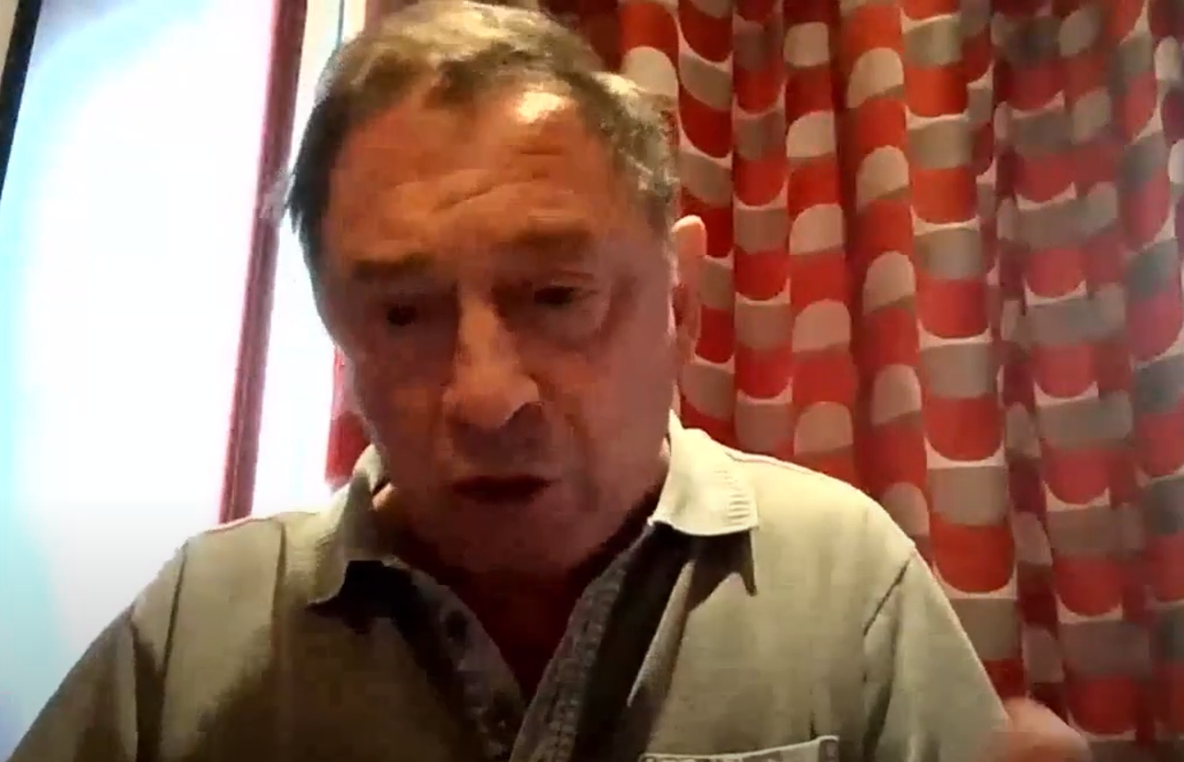
Recording: Prof. Guy Standing
(Click on the image to watch the presentation on Youtube)

Slide 37
Reflections: Prof. Guy Standing
Professor Guy Standing offered his reflections on the conference and what we had heard during the session.
Basic income is often advocated as a matter of common justice: giving basic security to everyone, and enhancing freedom by alleviating insecurity. We now live in an era of chronic insecurity and uncertainty and lack resilience: we don’t know who is vulnerable, we are all vulnerable.
Evidence from pilots and experiments of basic income provide the “low hanging fruit” – assessing the hypotheses about what impact basic income has and what is needed to make it relatively successful.
Community-wide pilots lead to strong multiplier effects, with more income generated in the community than the money spent on the pilot. It is important to recognise the community dynamics of basic income: cooperation within communities over pooling and spending newfound resources for the greater good. Many pilots only select specific groups, and these benefits are not observed.
It is vital that recipients of basic income pilots are anonymous, without media coverage of those receiving it, to ensure credibility. Privacy is vital for the credibility of research on basic income.
It is important to ensure that hypotheses are made explicit, including control variables and looking at previous results, to ensure that appropriate data is gathered.

Slide 38
Prof. Guy Standing: Findings from previous BI pilots
Findings from previous basic income pilots and experiments:
Mental
Health
Reduced mental stress, leading to less mental illness and lower morbidity
Health
Lower incidences of illness
Greater and more effective use of medicines – more likely to take a treatment to completion
Lower incidence of hospital and clinic visits, with implications for public health expenditure
Increased life expectancy and healthy life expectancy
Education
Improved school attendance and performance, including lifelong learning enrolment
Work
Increases in work, beyond labour force participation
Diversification of work: different types and multiple sources
Relationships
Emancipatory effect: people can move out of abusive relationships, as they are less financially dependent on their partner

Slide 39
Questions for Prof. Guy Standing
The “research burden” on the group receiving the pilot is a theme discussed throughout the session – how can we get the balance between recipient participation and administrative data?
It is important to have an open mind in how much the research burden will affect participants, if done in the right ways, people from a variety of backgrounds will be able to talk to a sympathetic questioner about their realities of receiving the scheme.
You mentioned that community-wide pilots, have strong multipliers effects – what are the benefits of a community-level approach?
Community schemes lead to legitimising of the process, and autonomy for those in the community to do what they want with their income, including giving it back to the community. Crime decreases if the whole community receives the basic income. If everyone in the community gets a basic income, increase in spending leads to increased investment, and then increased income. Multiplier effects are very important when considering the cost-effectiveness of the scheme, and potential benefits from the scheme can lead to spending reductions in other areas.

Slide 40
Resources

Slide 41
Speakers’ Resources
Before and during the event, we asked attendees to let us know of resources and outputs related to other basic income pilots or support for care leavers. We received 26 responses to the pre-event survey questionnaire highlighting other active and completed basic income schemes, as well as other useful resources. Attendees also mentioned several useful resources in the chat box throughout the event.
Welsh Government: Basic income pilot for care leavers: overview of the scheme
Speakers’ resources:
Marmot, M., et al.: Fair Society, Healthy Lives (The Marmot Review)
The Welsh Basic Income Evaluation (CASCADE)
Banerjee, A., et al.: Effects of a Universal Basic Income during the pandemic (Kenya)
McIntosh, C., and Zeitlin, A.: Using Household Grants to Benchmark the Cost Effectiveness of a USAID Workforce Readiness Program (Rwanda)
FSD Africa: Youth Enterprise Grants for the Informal Economy (Kenya)
Aggarwal, S., et al.: The Dynamic Effects of Cash Transfers: Evidence from Rural Liberia and Malawi
The RSA: The cost of independence: young people’s economic security.
The RSA: Age of insecurity
The RSA: Challenging the mental health crisis
Shlonsky, A., et al., Systematic review and meta-analysis: What works for young people leaving the out-of-home care system?
What Works for Children’s Social Care: Systematic Review: Experiences With Mental Health Provision For Care-experienced Young People In The UK
Standing, G., Basic Income: And How We Can Make It Happen
Standing, G. The Precariat: The New Dangerous Class

Slide 42
Other Basic Income Schemes
Publications related to specific basic income initiatives:
Initiative | Location | Timescale | Links
HudsonUP UBI Pilot | Hudson, New York | Active: 2020-2025 | Hudson Basic Income Pilot: Year One Report
Catalonia UBI Pilot | Catalonia | Active: 2023-2024 | Draft proposal for the design of the Catalonia pilot
WorkFree | Hyderabad, India | Active: 2022-23 | The WorkFREE project
Madhya Pradesh Unconditional Cash Transfers Project (MPUCT) | Madhya Pradesh, India | Completed: 2011-2014 | Piloting Basic Income Transfers in Madhya Pradesh, India
Ontario Basic Income Pilot | Ontario, Canada | Completed: 2018-2019 | The Impacts of the Ontario Basic Income Pilot: A Comparative Analysis
 |  |  | The Experiences of Employed and Unemployed Ontario Basic Income Recipients
 |  |  | Southern Ontario’s Basic Income Experience
Leeds Cash First Pilot | Leeds, UK | Completed: 2021-2022 | Cash First Literature Review
 |  |  | Evaluation of the Leeds City Council Cash Grant Pilot programme

Slide 43
Other Resources
Other Resources:
Review of basic income experiments in OECD countries
Special issue on the policy impact of European basic income experiments
Preventing homelessness in care experienced individuals
Millennium Cohort Study
Systematic scoping review of studies of basic income-like interventions
Young Foundation evaluation of B-MINCOME in Barcelona
Ongoing results from the Changing Cost of Living Survey in the UK and France
Assessing the Feasibility of Citizens’ Basic Income Pilots in Scotland
The RSA: A Basic Income for Scotland
Exploring the practicalities of a basic income pilot

Slide 44
Speaker biographies

Slide 45
Speaker biography: Professor Sir Michael Marmot
Professor Sir Michael Marmot has been Professor of Epidemiology at University College London since 1985, and is Director of the UCL Institute of Health Equity. He is the author of The Health Gap: the challenge of an unequal world (Bloomsbury: 2015), and Status Syndrome (Bloomsbury: 2004).
Professor Marmot is the Advisor to the WHO Director-General, on social determinants of health, in the new WHO Division of Healthier Populations; Distinguished Visiting Professor at Chinese University of Hong Kong (2019-), and co-Director of the of the CUHK Institute of Health Equity. He is the recipient of the WHO Global Hero Award; the Harvard Lown Professorship (2014-2017); the Prince Mahidol Award for Public Health (2015), and 19 honorary doctorates. Marmot has led research groups on health inequalities for nearly 50 years. He chaired the WHO Commission on Social Determinants of Health, several WHO Regional Commissions, and reviews on tackling health inequality for governments in the UK.
He served as President of the British Medical Association (BMA) in 2010-2011, and as President of the World Medical Association in 2015. He is President of the British Lung Foundation. He is a Fellow of the Academy of Medical Sciences and Honorary Fellow of the American College of Epidemiology and of the Faculty of Public Health; an Honorary Fellow of the British Academy; and of the Royal Colleges of Obstetrics and Gynaecology, Psychiatry, Paediatrics and Child Health, and General Practitioners. He is an elected member of the US National Academy of Medicine and of the Brazilian Academy of Medicine.
He was a member of the Royal Commission on Environmental Pollution for six years and in 2000 he was knighted by Her Majesty The Queen, for services to epidemiology and the understanding of health inequalities.

Slide 46
Speaker biography: Professor Guy Standing
Professor Guy Standing is a cofounder, and currently the co-president of the Basic Income Earth Network. He has designed basic income pilots in several countries, and has written many articles and books on BI, including one on large-scale pilots in India, as well as Basic Income: And how we can make it happen (Pelican) and Battling Eight Giants (Bloomsbury), the latter stemming from a report for the Shadow Chancellor on a proposed pilot in the UK. He advised on Finland’s basic income pilot, and pilots in California, Ontario, and England. He has recently been advising the Catalonian presidency on a planned BI pilot and is advising the UNDP on a pilot in Nepal. His most recent book is The Blue Commons: Rescuing the Economy of the Sea. It includes a rationale for basic income, based on regarding the commons as belonging to all of us, and therefore justifying a Commons Dividend based on levies on those who benefit financially from taking the commons.

Slide 47
Speaker biography: Adam Jones
Adam Jones is Senior Policy Officer – Basic Income Pilot, Welsh Government, a position he has held since February 2022.
Adam holds a BA (Hons) in Politics from the University of Wales Institute, Cardiff and MScEcon Politics and Public Policy from Cardiff University, and is currently seconded to Welsh Government from Public Health Wales, where he worked from December 2009 – January 2022, latterly as Senior Policy Officer.
His influential 2021 Public Health Wales report on Basic Income, Health and Wales followed an extensive interest in the subject, and he has presented on the subject to a range of organisations, including the Political Studies Association and the Basic Income World Congress.
Aside from his role informing Basic Income policy, Adam has undertaken policy work on a range of public health topics, most notably sexual health, HIV and public health policy, such as co-leading the independent review of sexual health in Wales and informing policy work to implement Pre-Exposure Prophylaxis (PrEP) for HIV prevention in Wales.

Slide 48
Speaker biography: Launa Anderson
Following a BSc and an MSc in Psychology, Launa Anderson has worked as a Government Social Researcher at the Welsh Government for over twenty years. She heads up the Social Research team within the Equality, Poverty and Childrens Evidence and Support Division with responsibility for supporting policy colleagues across Communities and Tackling Poverty with their research and evaluation requirements. Her team has taken the lead on scoping, designing, commissioning and project management of the Basic Income for Care Leavers in Wales pilot evaluation

Slide 49
Speaker biography: Professor Sally Holland
Professor Sally Holland is a Professor of Social Work. Her research interests include child and family social work, children’s rights and child and youth involvement in both research and policy-making. Her research centre is CASCADE Children’s Social Care Research and Development Centre where she leads on public involvement and public affairs. From 2015 to 2022 Prof Holland was Children’s Commissioner for Wales. She is the Director of Equalities, Diversity and Inclusion for the School of Social Sciences and is currently leading the evaluation of the Welsh Government's Basic Income Pilot for Care Leavers, alongside David Westlake.

Slide 50
Speaker biography: David Westlake
David Westlake is a Senior Research Fellow in CASCADE, part of Cardiff University. He researches child and family social work, and his career to date has included a wide range of topics within and around this field. David’s recent work has involved evaluating complex interventions using a wide range of methods. He is currently leading an evaluation of a £10 million policy initiative which puts social workers in schools, working with Cardiff’s Centre for Trials Research and Oxford University. The study is a Randomised Controlled Trial (RCT) with process and economic evaluations, and follows a feasibility study that he completed earlier this year on the same topic. Previously, David led a research team that worked within a child protection service, with a remit to provide evaluative feedback on practice and inform service improvement.

Slide 51
Speaker biography: Dr Miriam Laker-Oketta
Dr Miriam Laker-Oketta is the Global Director of Research at GiveDirectly and a Senior Research Scientist and Epidemiologist with nearly two decades of experience conducting research. Amongst her extensive experience, she provides institutional oversight for rigorous, experimental evaluation of the impacts of unconditional cash transfers, among which is the largest ever Universal Basic Income Randomized controlled trial ongoing in Kenya. She currently supervises GiveDirectly’s more than one dozen randomized controlled trials with leading researchers in the field. She also leads the monitoring and evaluation activities of the organization and supports fundraising efforts.

Slide 52
Speaker biography: Hannah Webster
Hannah Webster is Head of Research at the RSA and previously co-led the organisation’s People and Place programme. She is an experienced quantitative, qualitative and participatory researcher with a focus on economic security, wellbeing, housing and young people’s advocacy in her work. In 2022, Hannah was part of a partnership led by Northumbria University exploring the health and wellbeing impacts of a UBI, for which her team led on the qualitative enquiry.

Slide 53
Speaker biography: Dr Eleanor Ott
Dr Eleanor Ott is a Senior Advisor at the Centre for Evidence and Implementation (CEI). She has led research to improve the lives of children and families facing adversity across academia, government, and non-profit organisations. She is also a research methodologist focused on evidence synthesis and systematic reviews, mixed-methods research, and impact evaluations.
Previously, Eleanor managed research, knowledge exchange, impact evaluations, and systematic reviews around children’s social care at the Rees Centre at the University of Oxford and led the Humanitarian Evidence Programme at Oxfam. She has a doctorate from the Centre for Evidence-Based Intervention at the University of Oxford, where she studied as a Rhodes Scholar. Dr Ott also holds an MSc in Refugee and Forced Migration Studies from the University of Oxford. Eleanor has been a consultant to the UN Refugee Agency and previously worked as a research analyst and Truman-Albright Fellow in the US Department of Health and Human Services, improving research on children and families.
At CEI, Eleanor is responsible for a portfolio of evaluation, research, and evidence synthesis projects, including those that seek to improve services and the lives of children with a social worker and separated migrant children. She is also a foster carer.

Slide 54
End of highlights pack

